Slide 1
Data Centers: Topology, Traffic and Routing
Irfan Ali
Application of SDN to Data Center Networks
Slides adapted Ankit Singla, Hakim Weatherspoon &
other sources on Internet

Slide 2
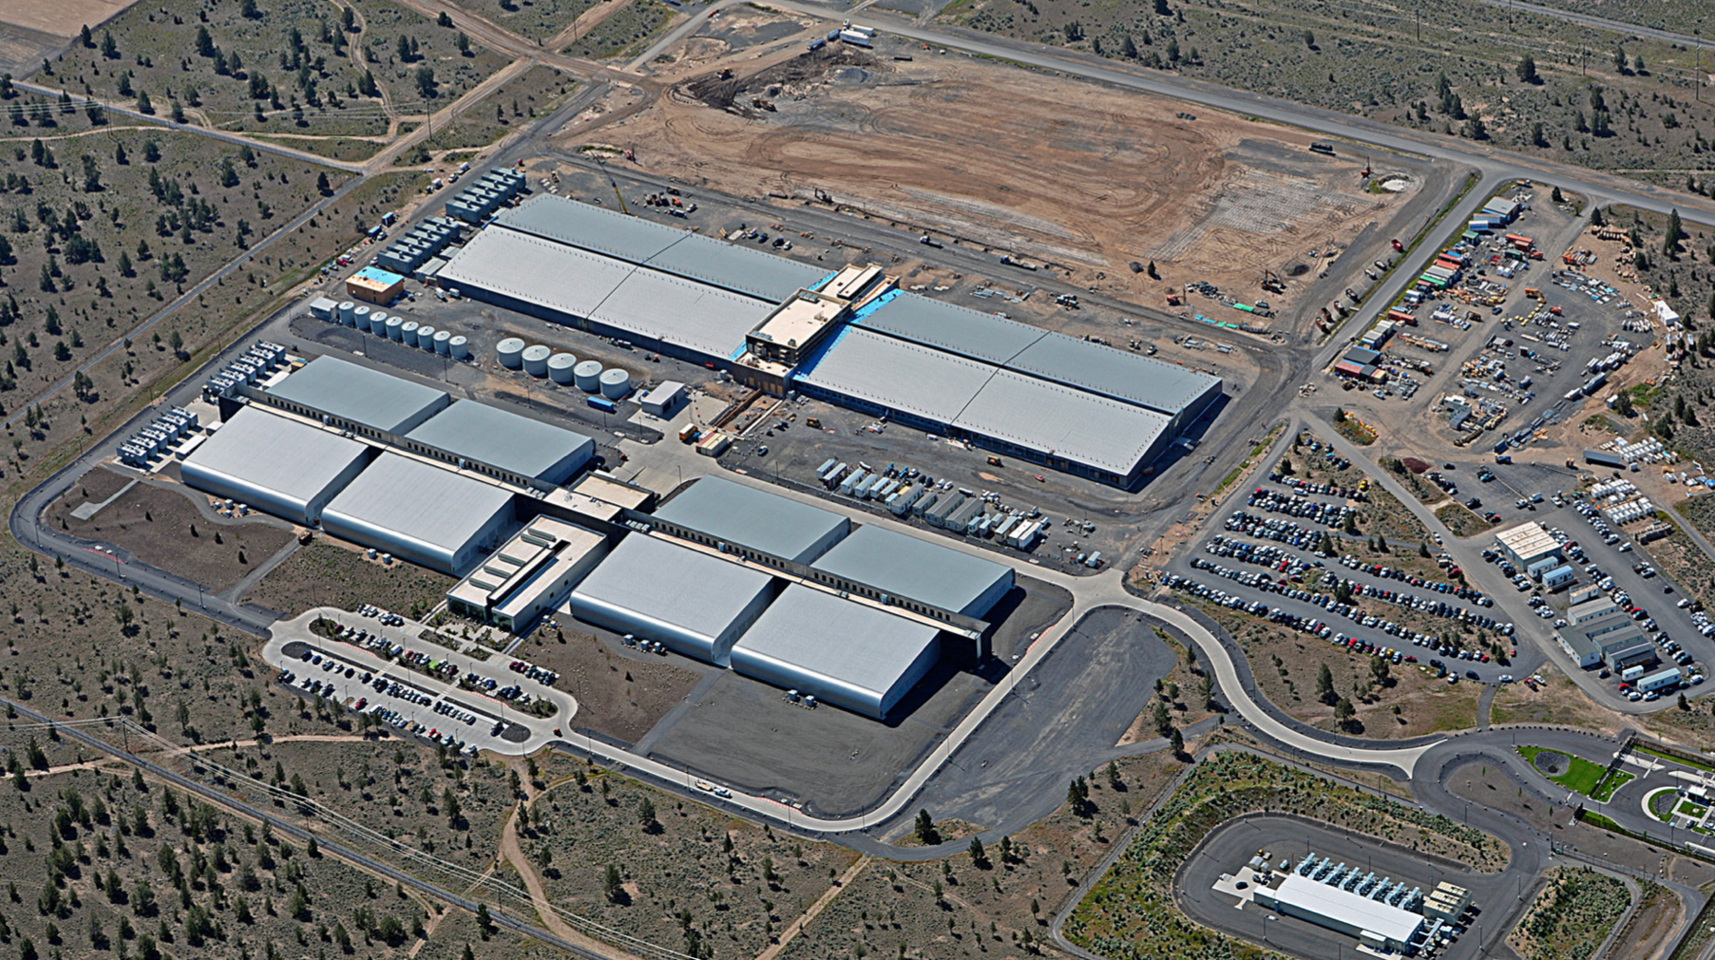
Data Center

Slide 3
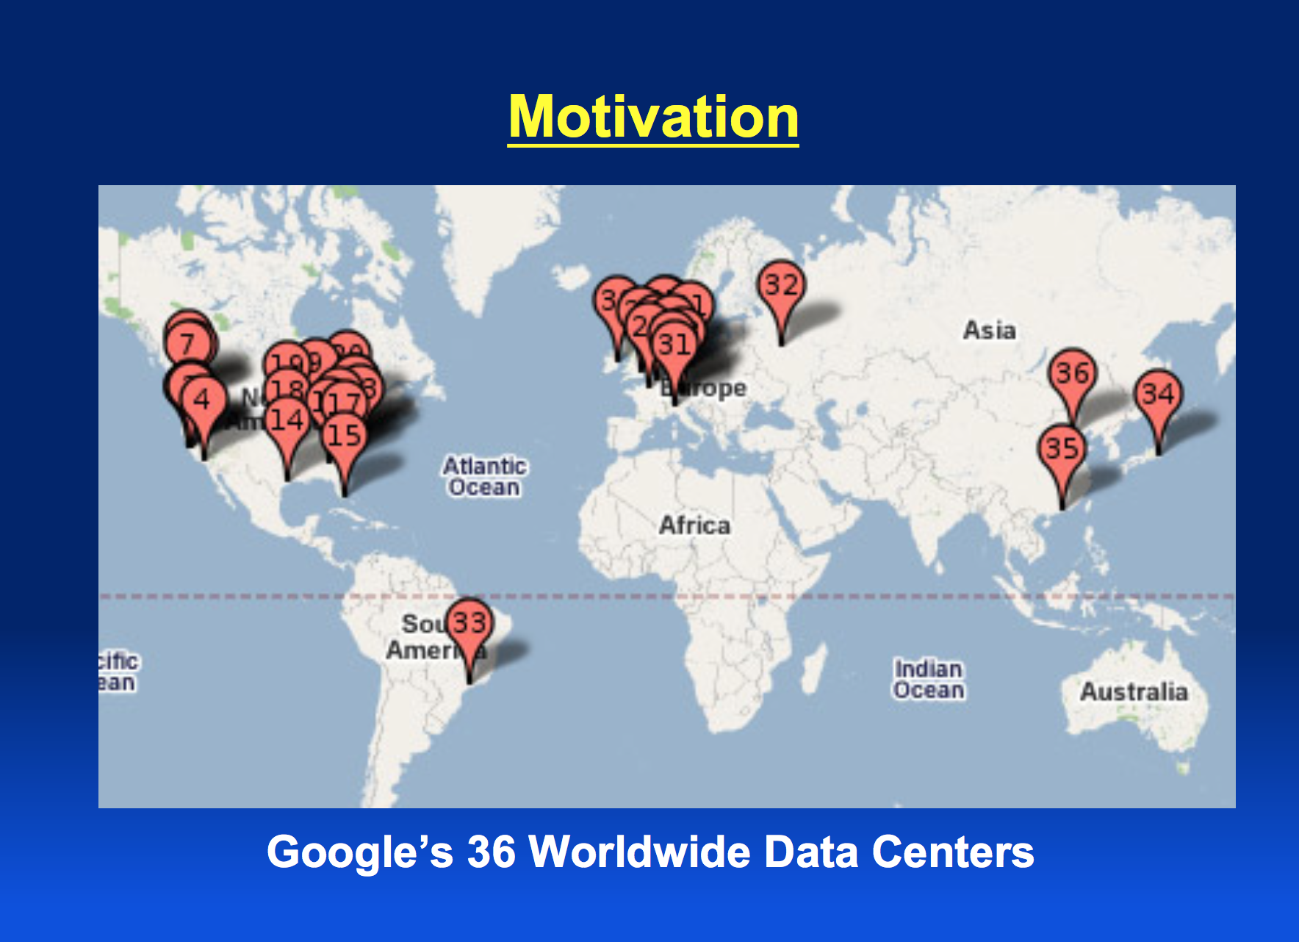

Slide 4
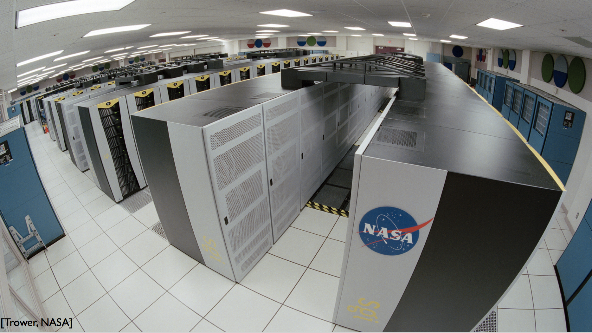

Slide 5
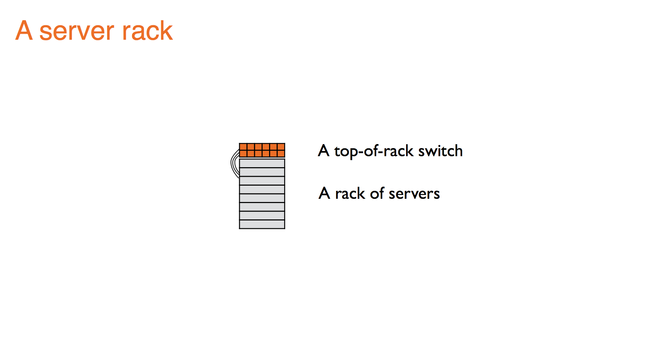

Slide 6
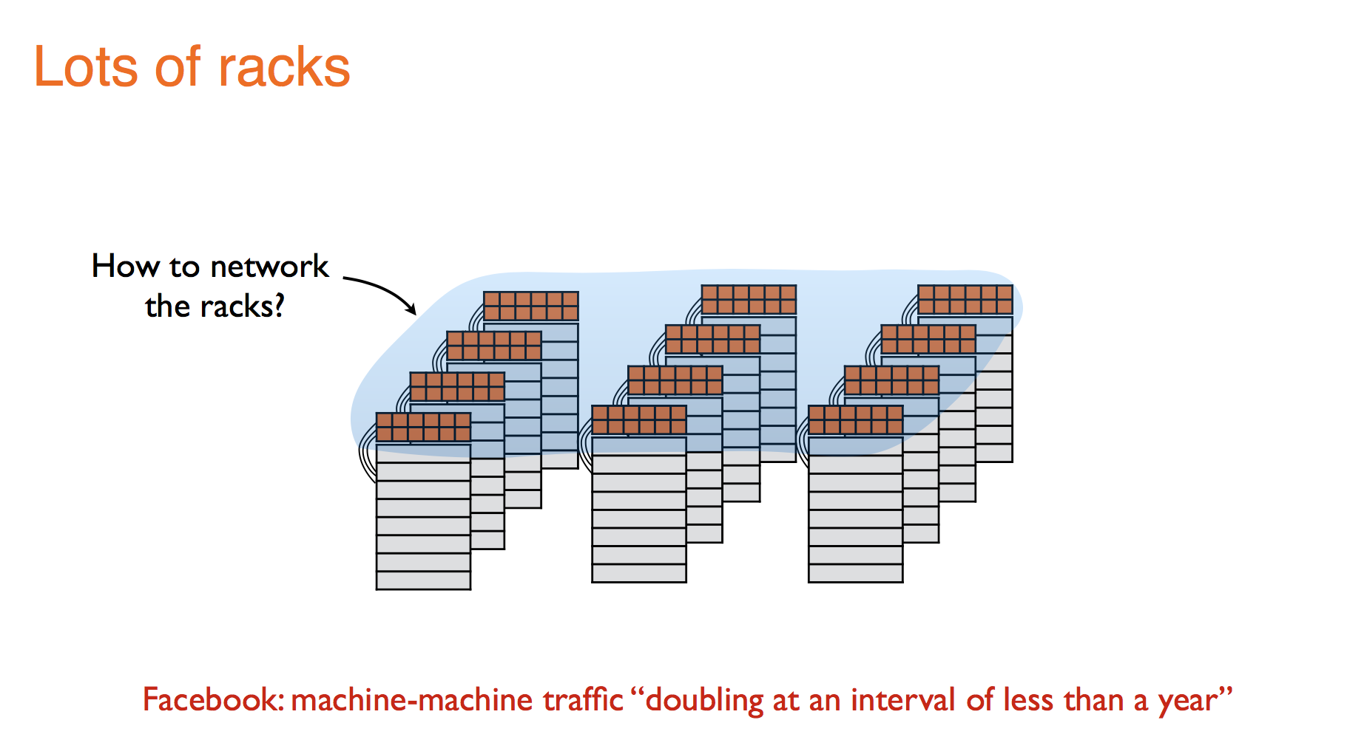

Slide 7
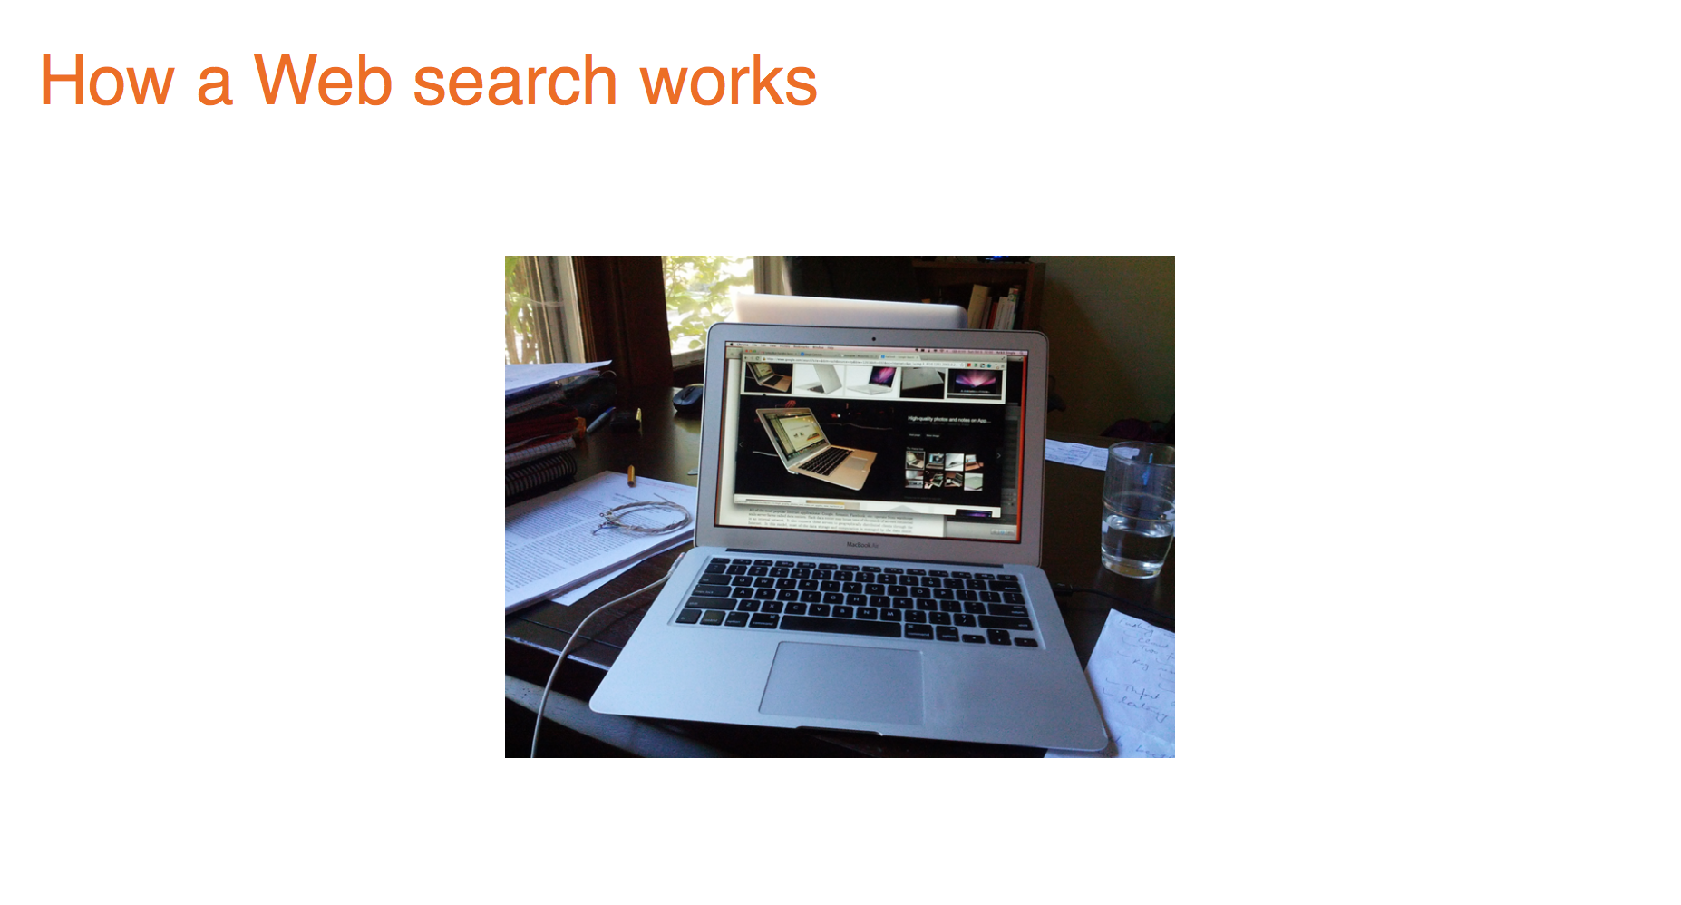

Slide 8
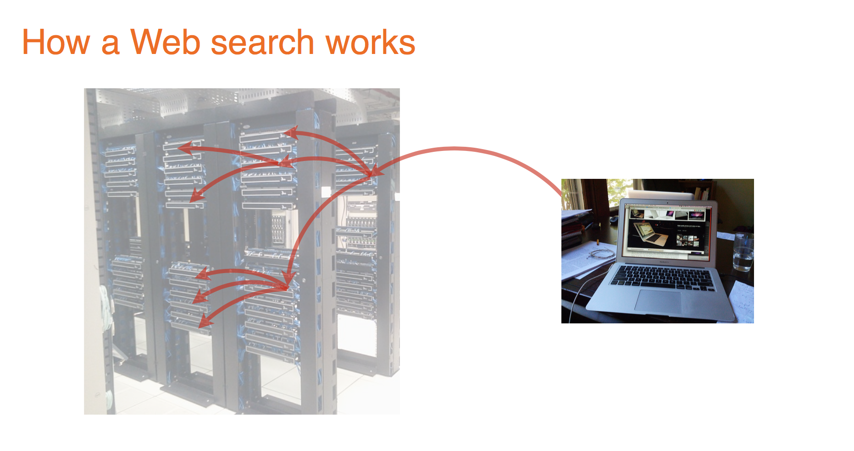

Slide 9
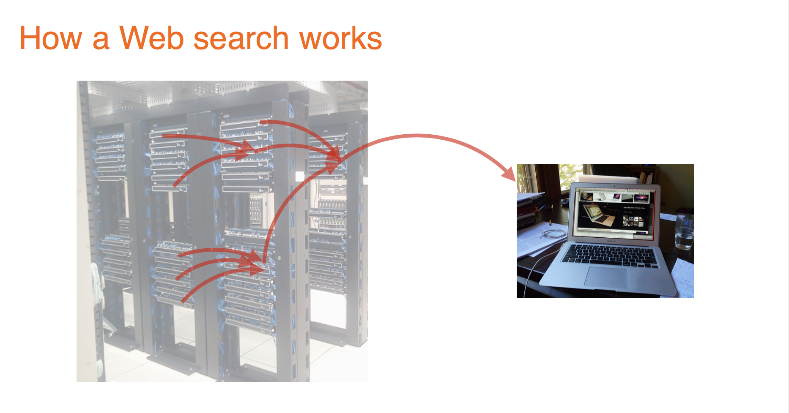

Slide 10
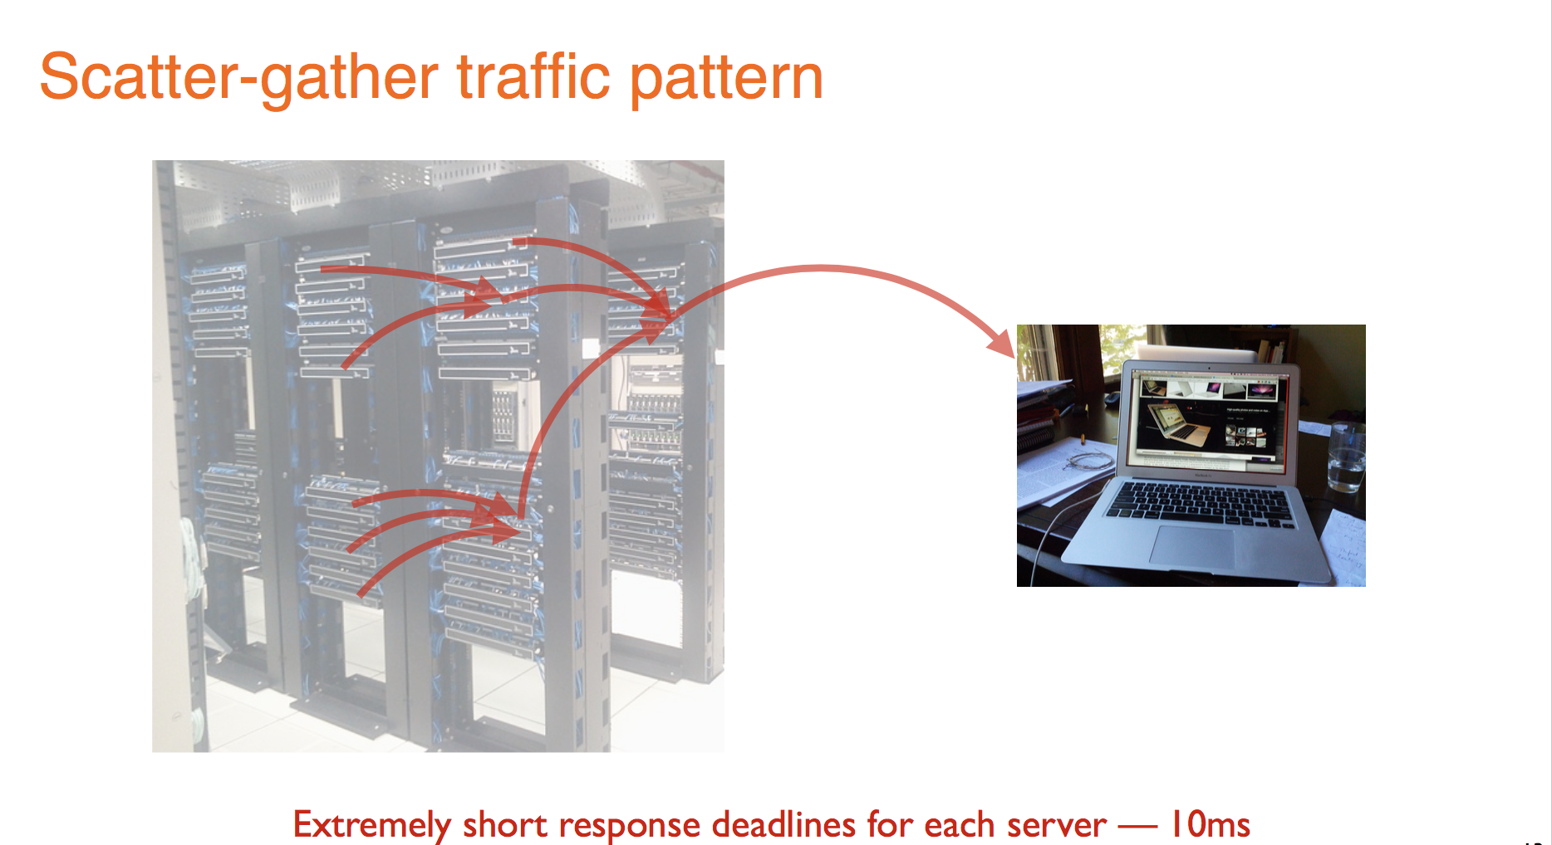

Slide 11
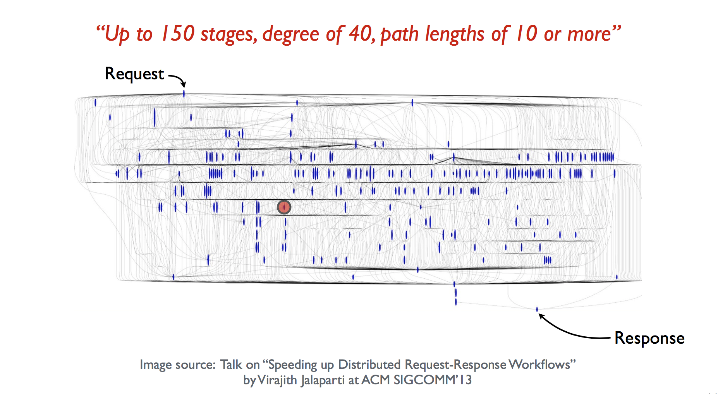

Slide 12
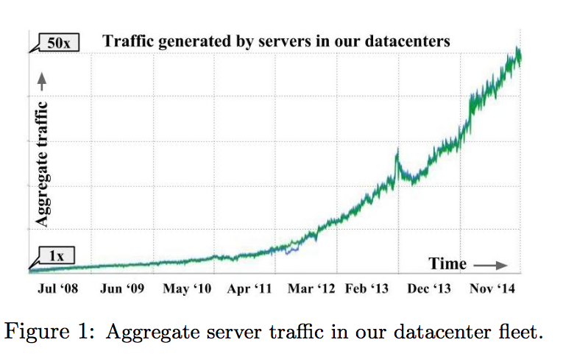
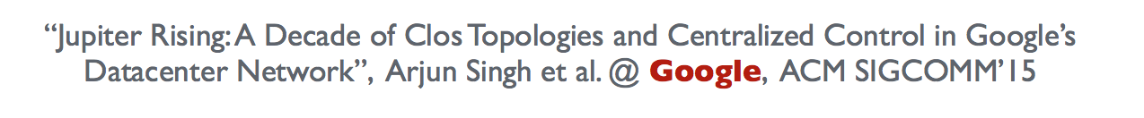


Slide 13
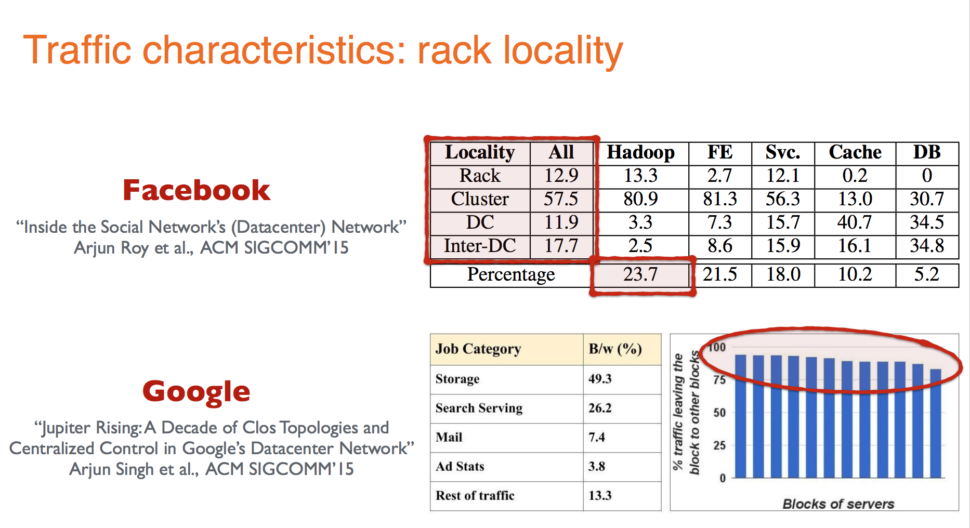

Slide 14
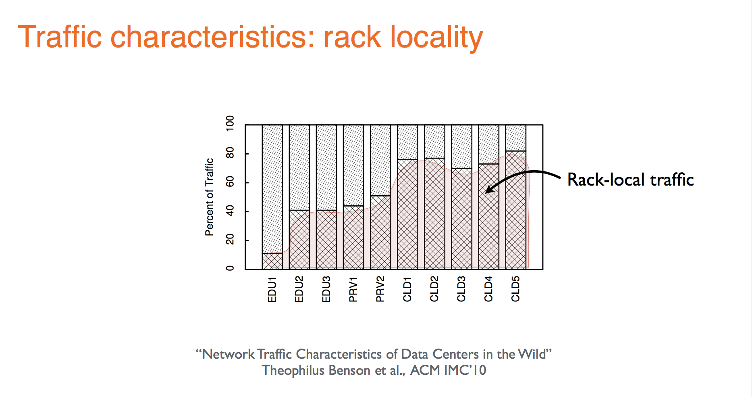

Slide 15
Conclusion on Rack Locality
Large traffic out of rack
Applications and virtual machines migrate: Cannot make assumption that all traffic is within rack
Need to engineer network for high inter-rack traffic.

Slide 16
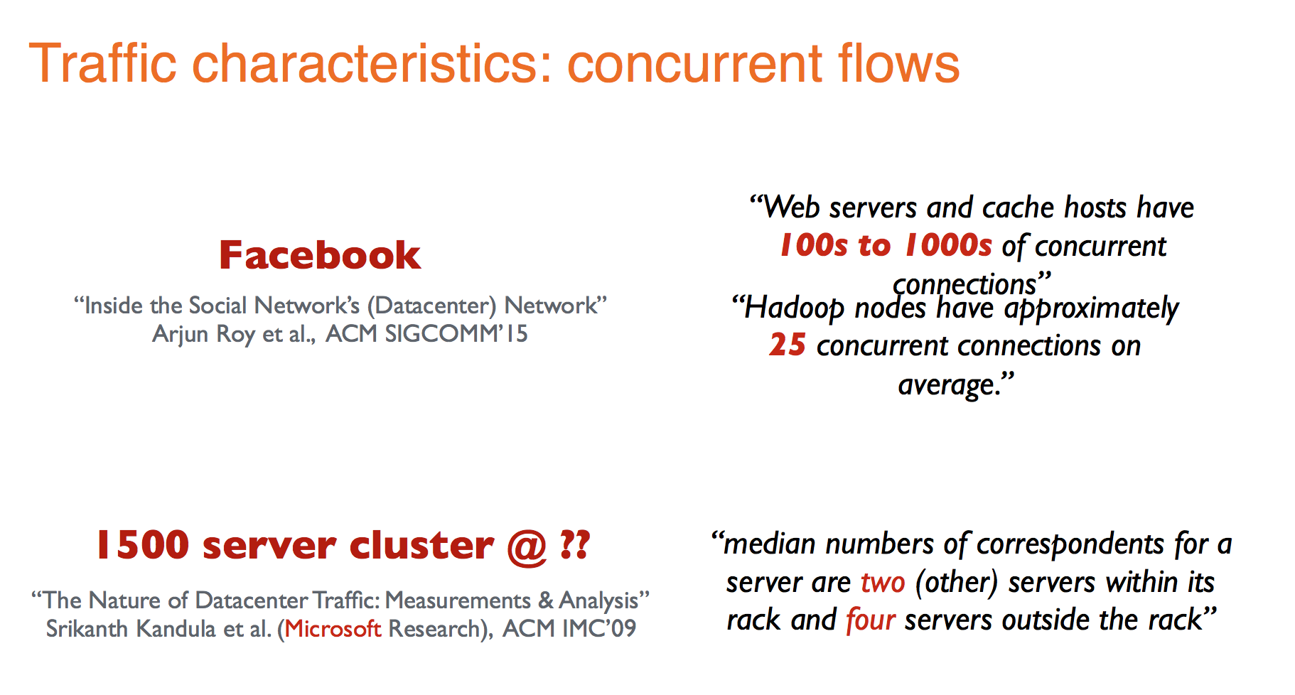

Slide 17
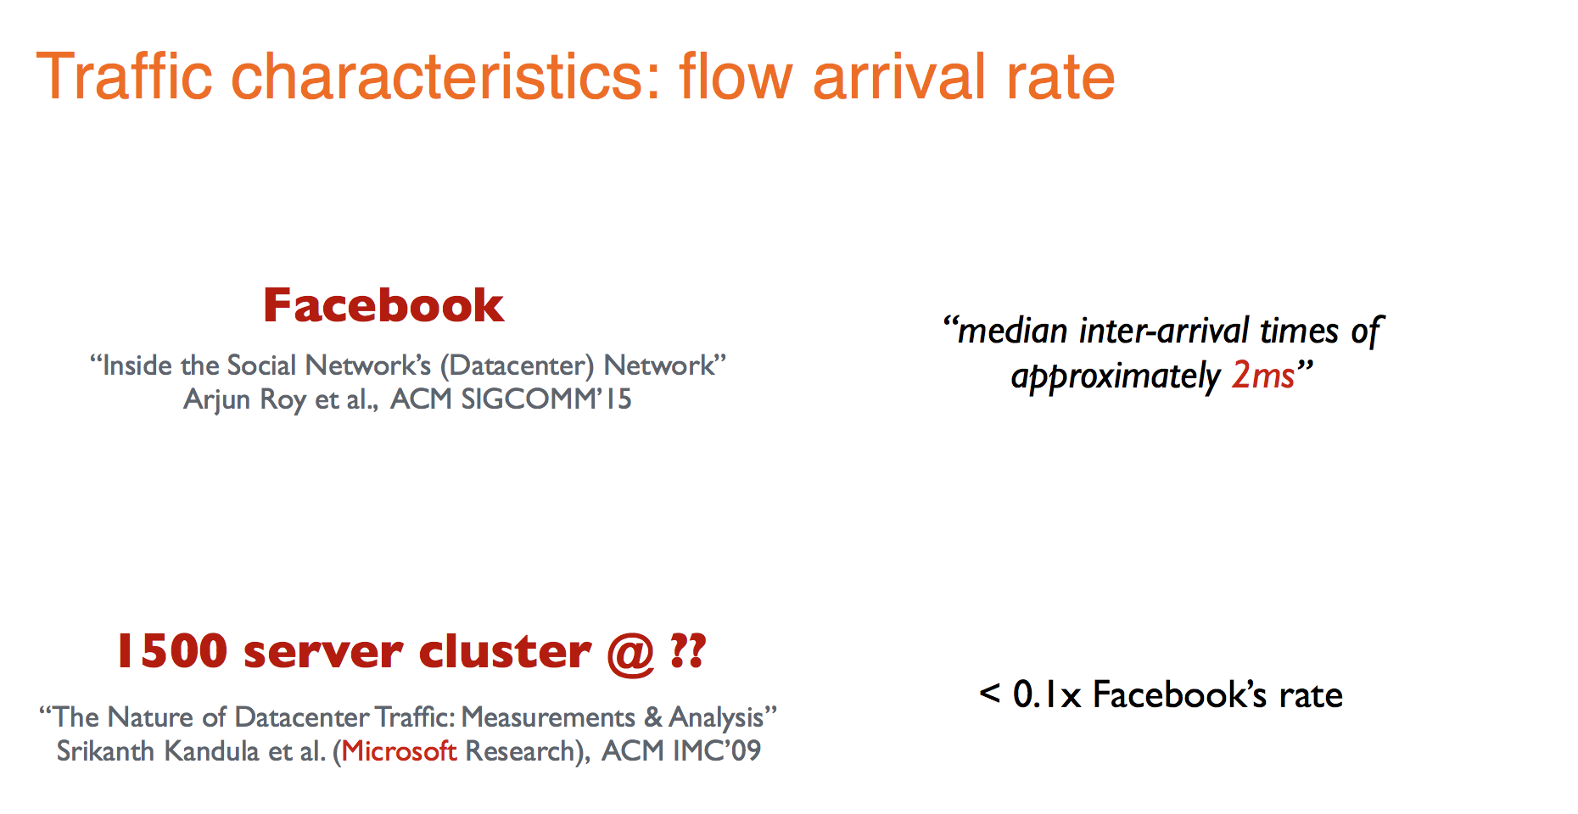

Slide 18
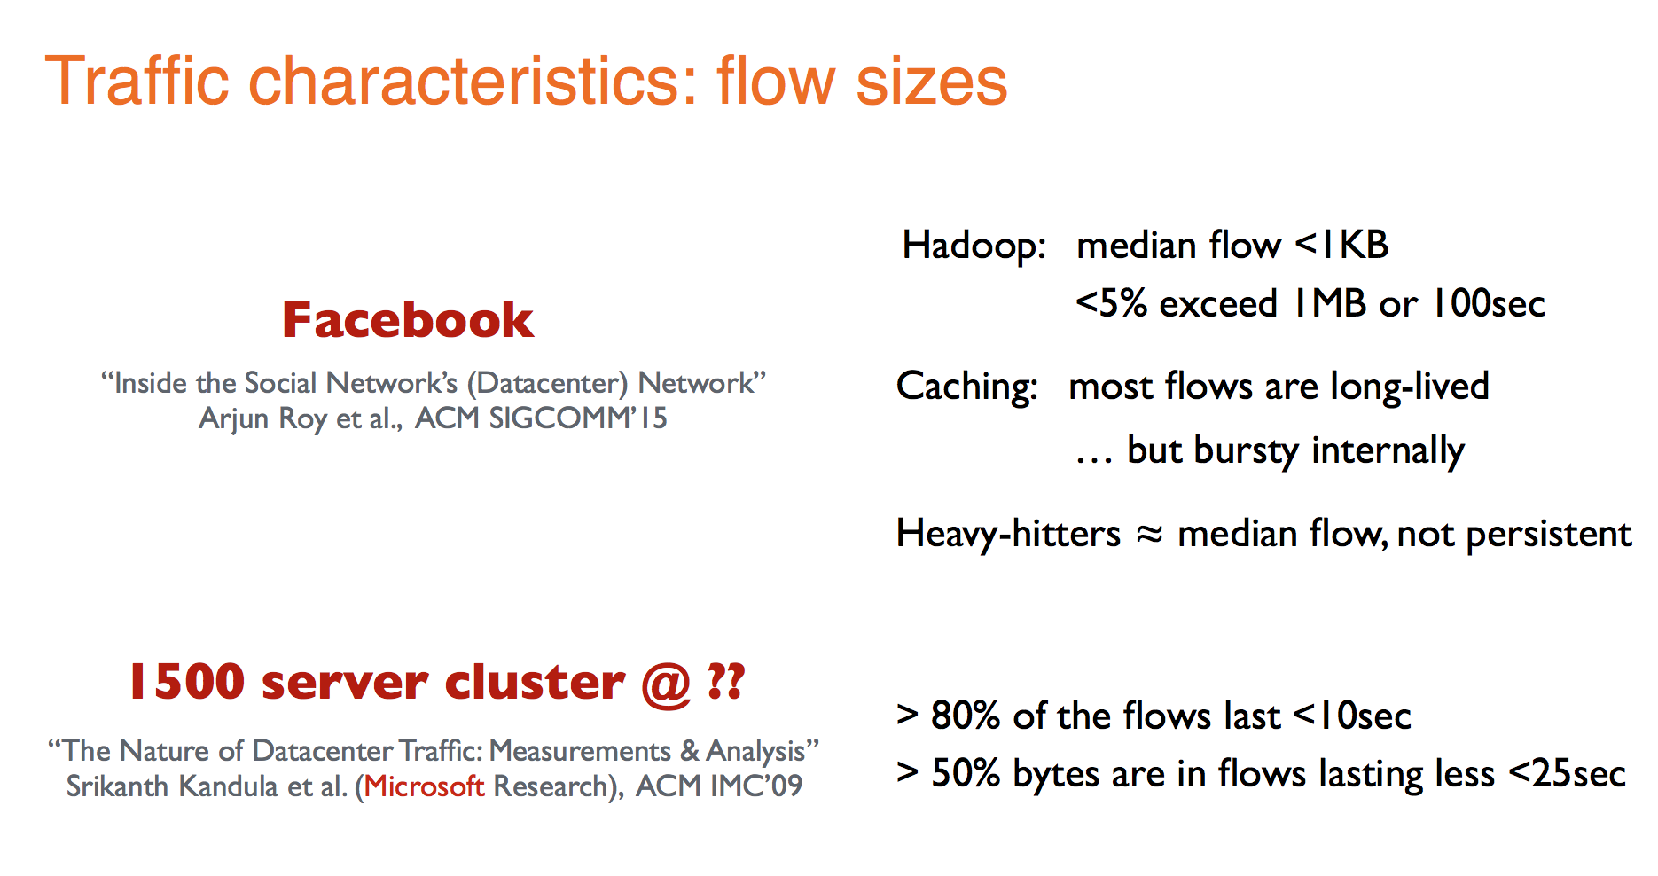

Slide 19
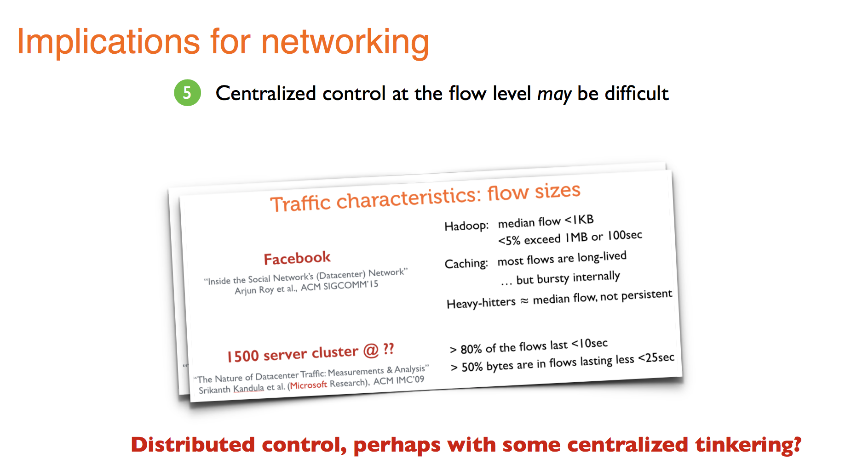

Slide 20
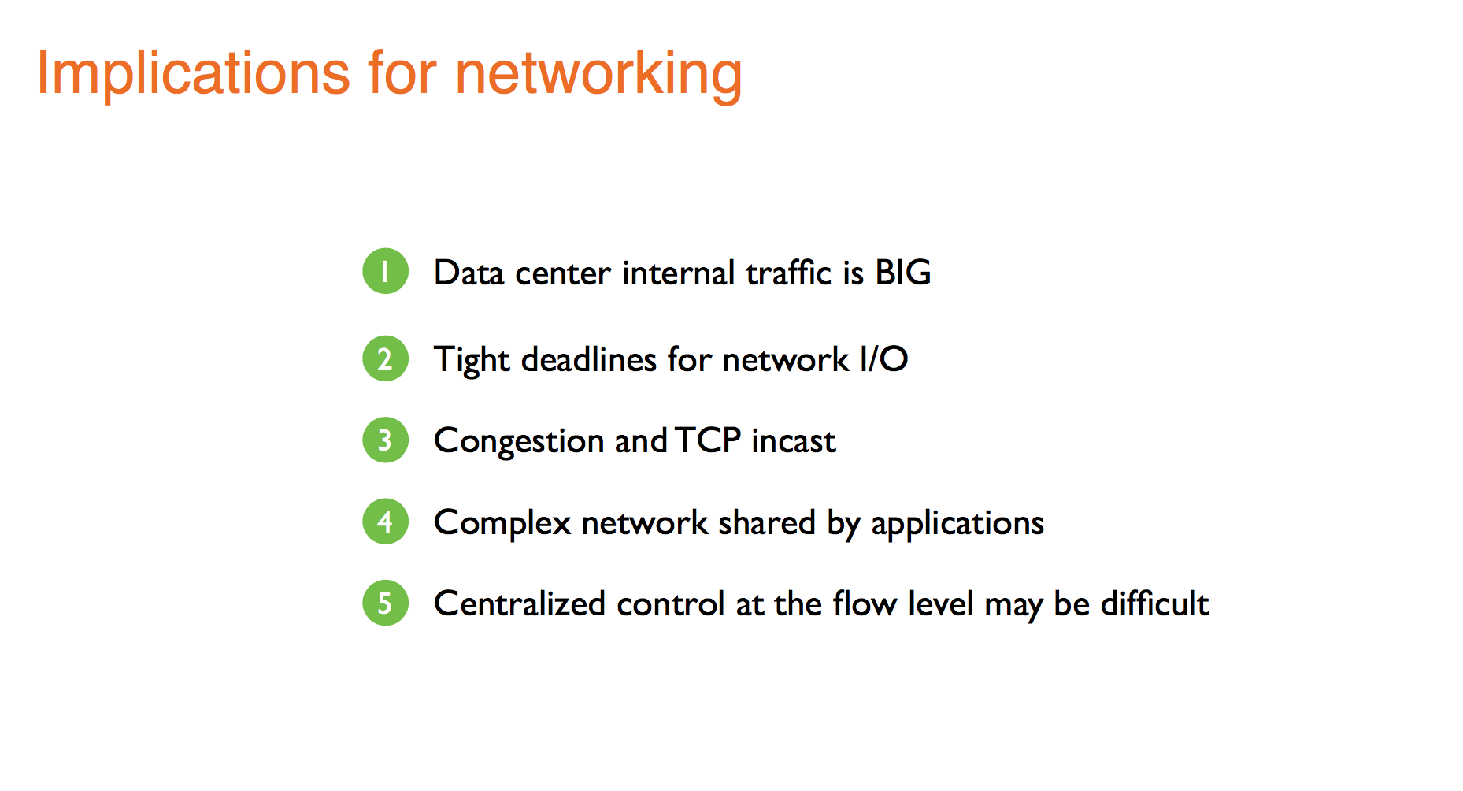

Slide 22
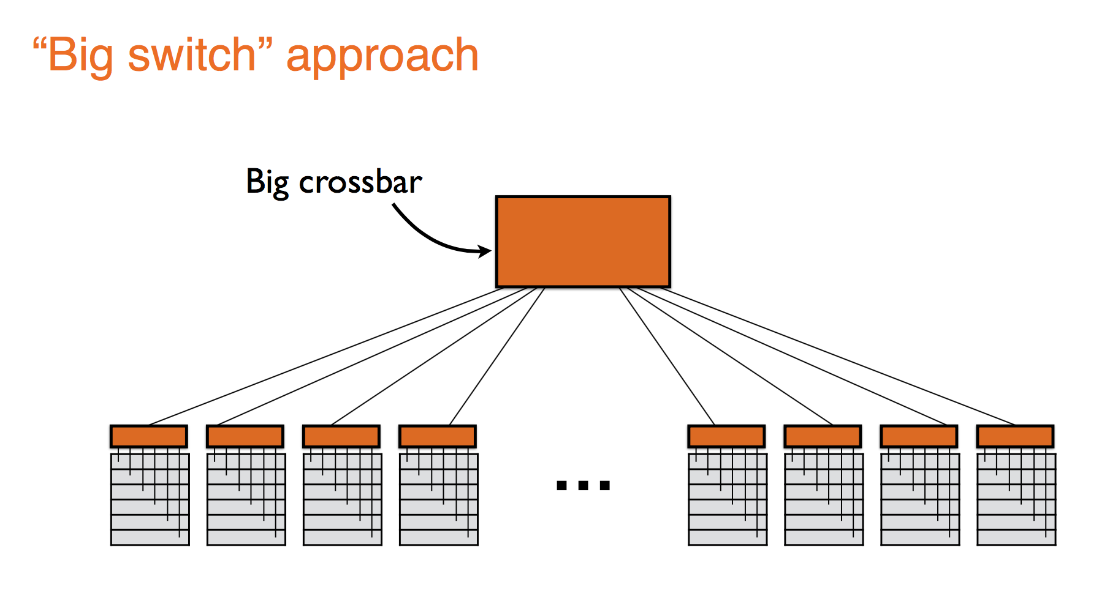

Slide 23
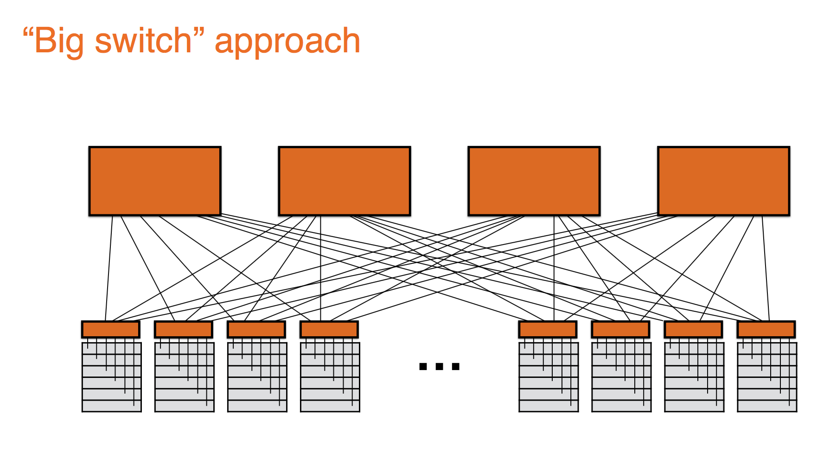

Slide 24
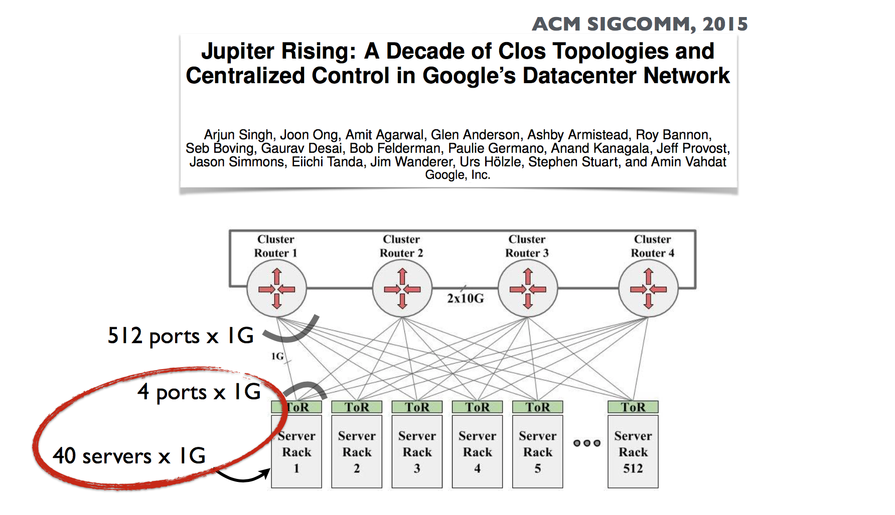

Slide 25
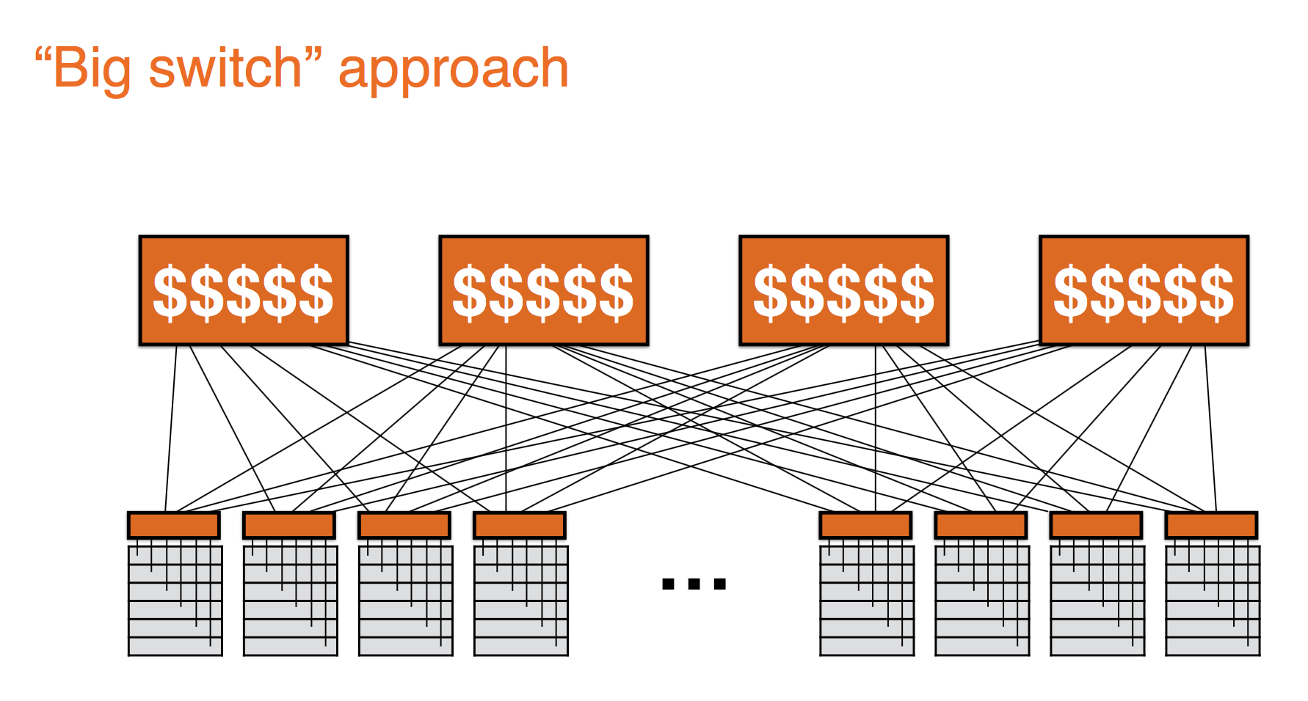

Slide 26
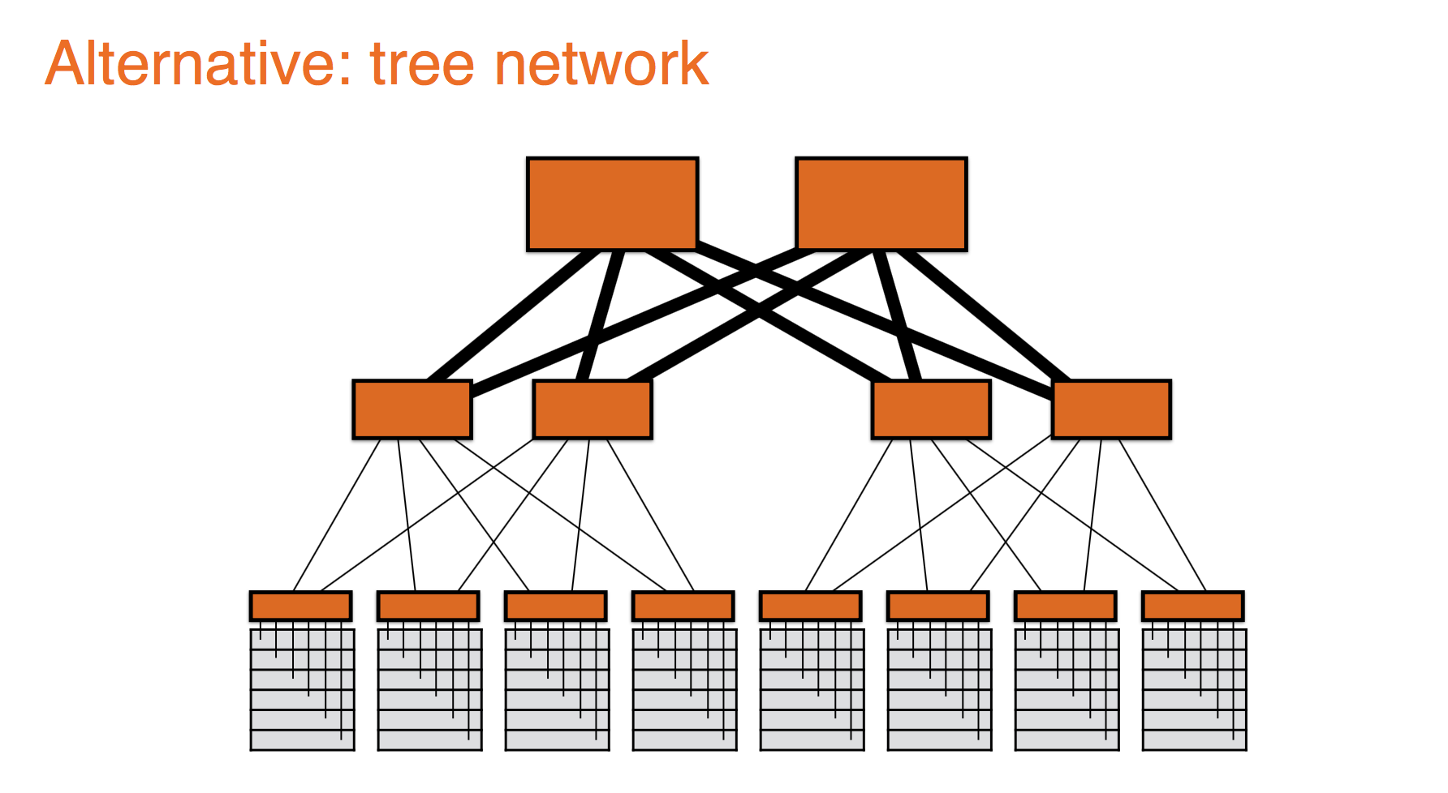

Slide 27
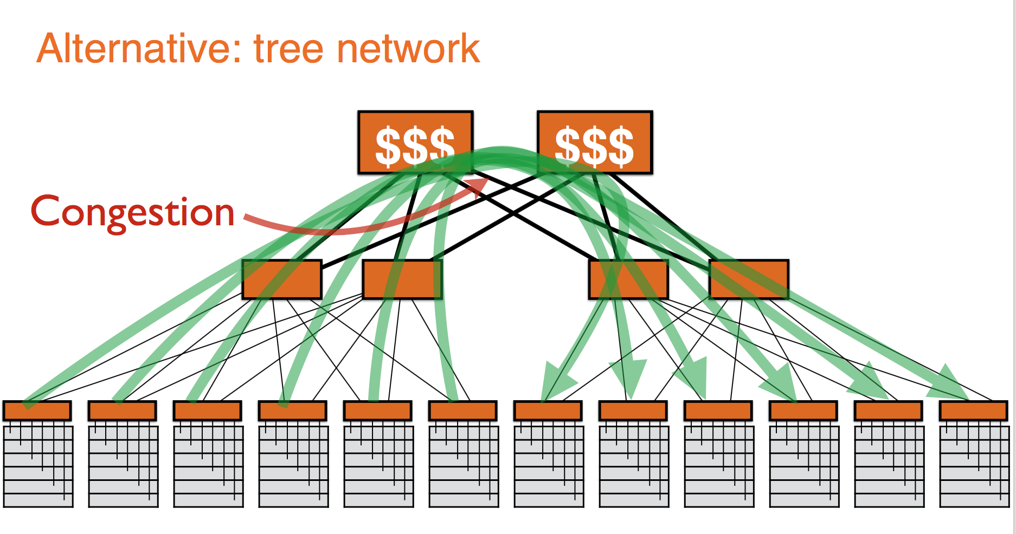

Slide 28
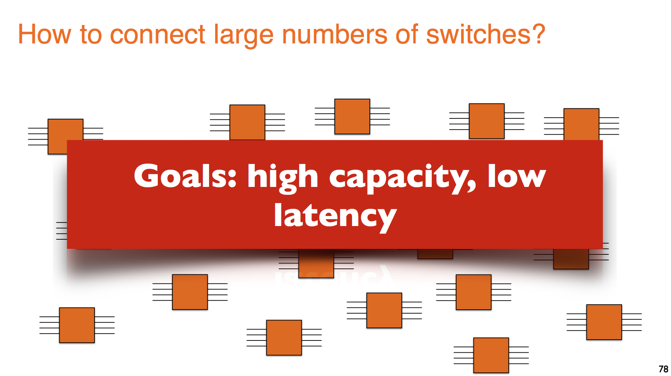

Slide 29
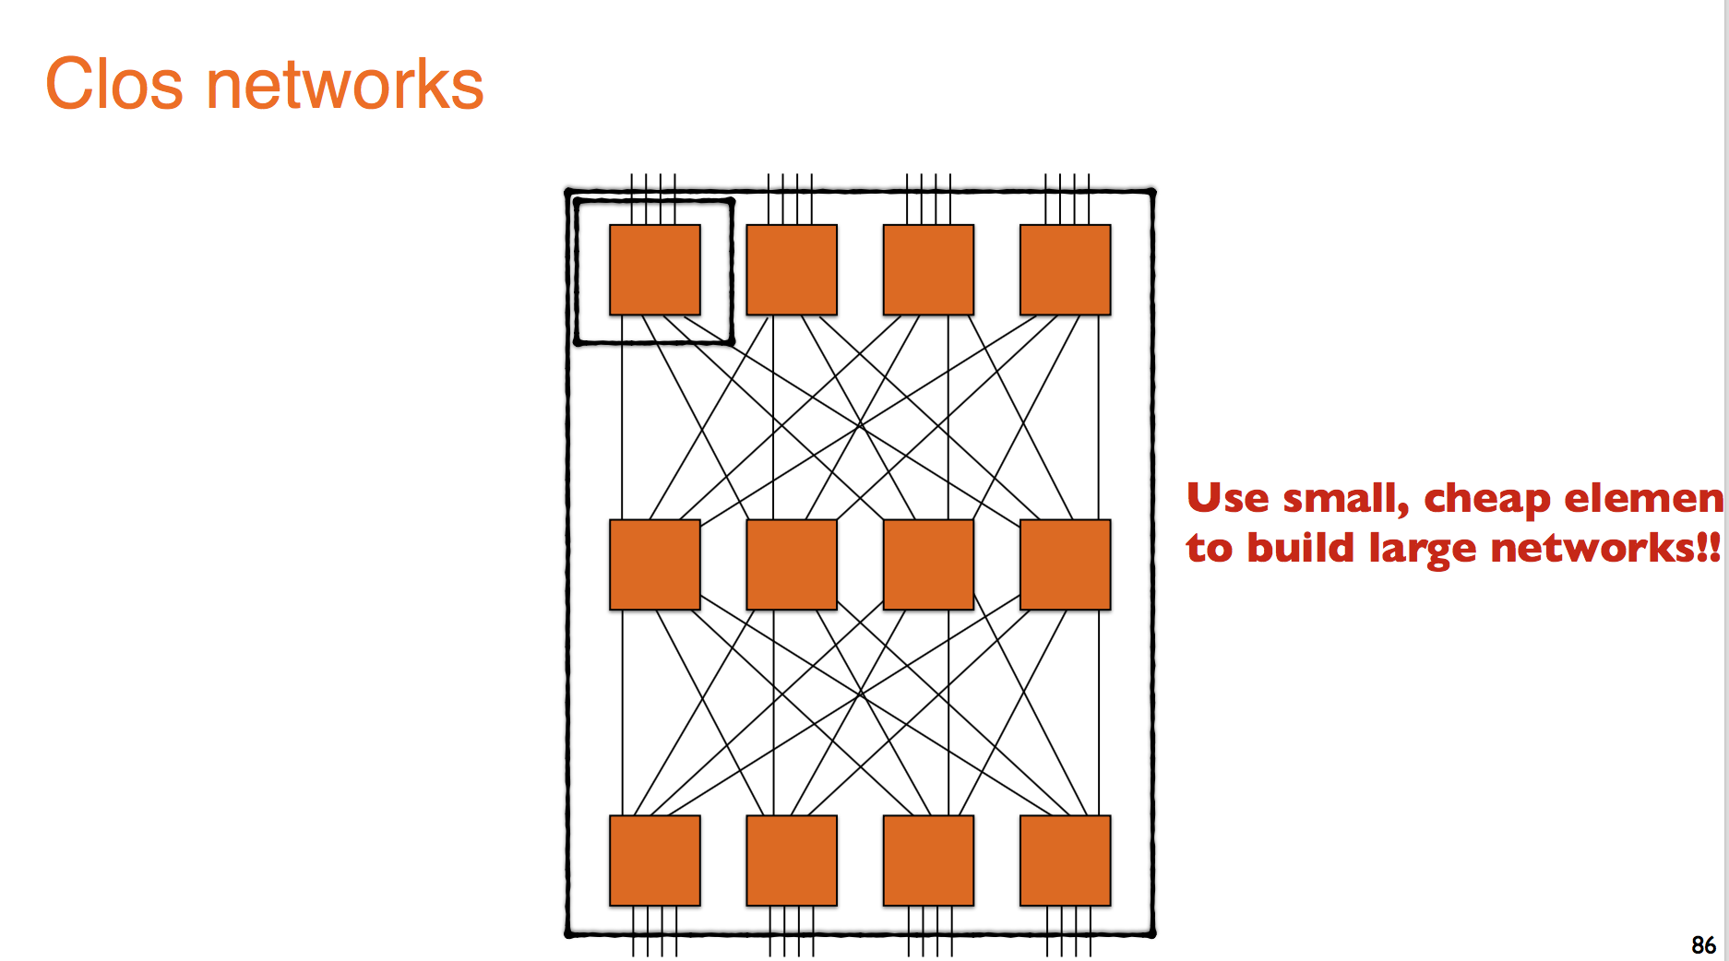

Slide 30
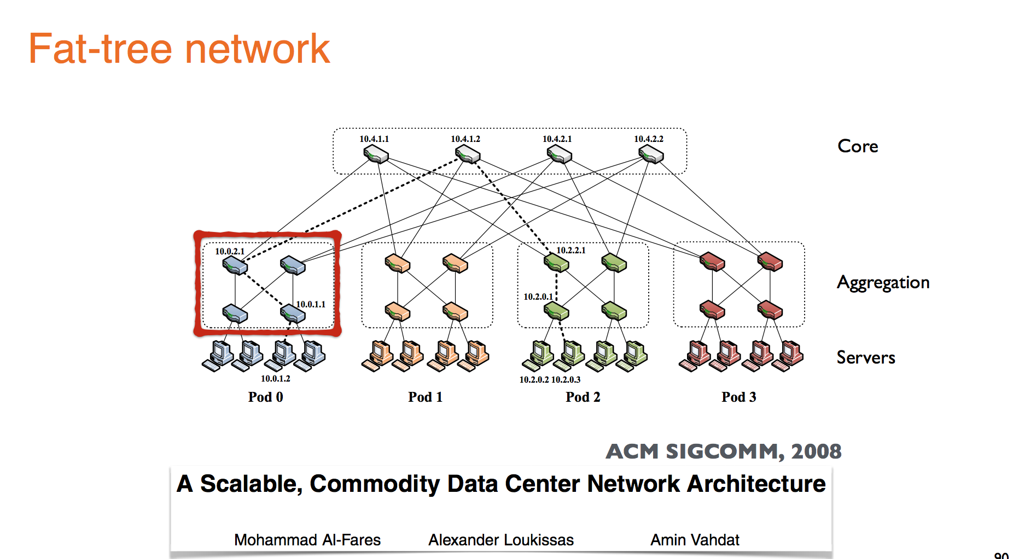

Slide 31
Background
Topology:
2 layers: 5K to 8K hosts
3 layer: >25K hosts
Switches:
Leaves: have N GigE ports (48-288) + N 10 GigE uplinks to one or more layers of network elements
Higher levels: N 10 GigE ports (32-128)
Multi-path Routing:
Ex. ECMP
without it, the largest cluster = 1,280 nodes
Performs static load splitting among flows
Lead to oversubscription for simple comm. patterns
Routing table entries grows multiplicatively with number of paths, cost ++, lookup latency ++

Slide 32
Common Data Center Topology
Internet
Data Center
Core
Layer-3 router
Aggregation
Layer-2/3 switch
Access
Layer-2 switch
Servers

Slide 33
Background
Oversubscription:
Ratio of the worst-case achievable aggregate bandwidth among the end hosts to the total bisection bandwidth of a particular communication topology
Lower the total cost of the design
Typical designs: factor of 2:5:1 (400 Mbps)to 8:1(125 Mbps)
Cost:
Edge: $7,000 for each 48-port GigE switch
Aggregation and core: $700,000 for 128-port 10GigE switches
Cabling costs are not considered!

Slide 34
Current Data Center Network Architectures
Leverages specialized hardware and communication protocols, such as InfiniBand, Myrinet.
These solutions can scale to clusters of thousands of nodes with high bandwidth
Expensive infrastructure, incompatible with TCP/IP applications
Leverages commodity Ethernet switches and routers to interconnect cluster machines
Backwards compatible with existing infrastructures, low-cost
Aggregate cluster bandwidth scales poorly with cluster size, and achieving the highest levels of bandwidth incurs non-linear cost increase with cluster size

Slide 35
Problems with common DC Topology
Single point of failure
Over subscript of links higher up in the topology
Trade off between cost and provisioning

Slide 36
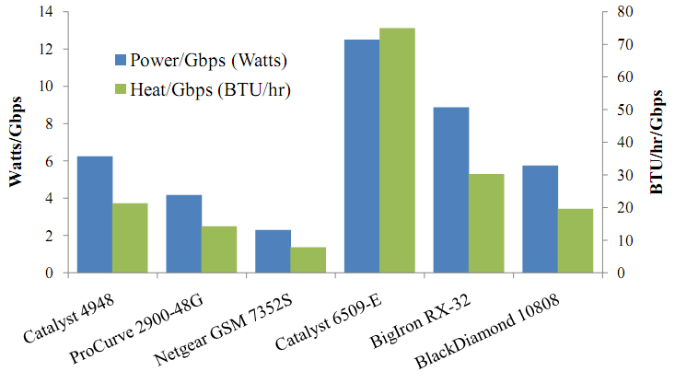
Cost of maintaining switches

Slide 37
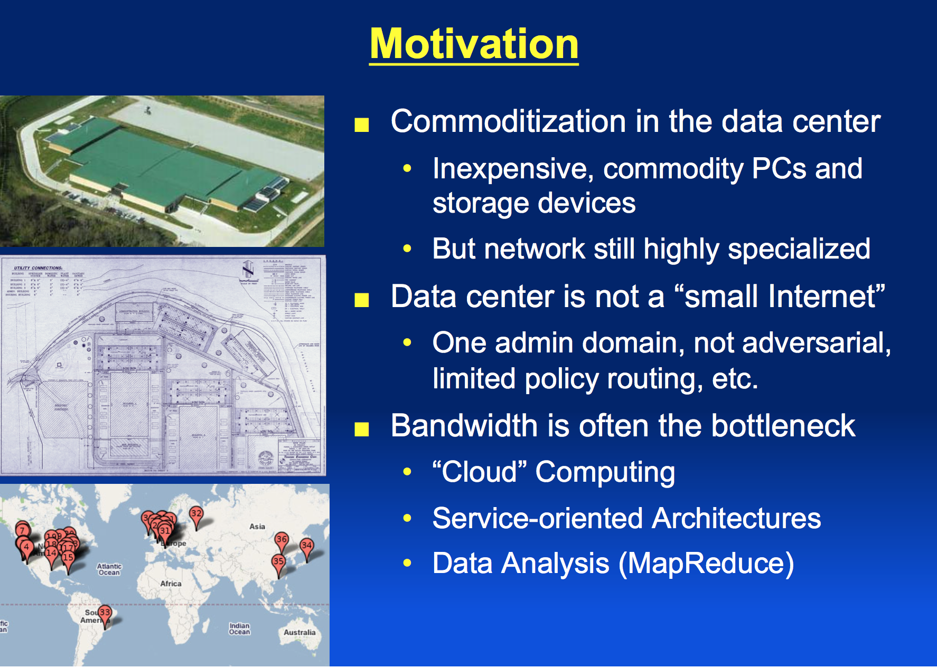

Slide 38
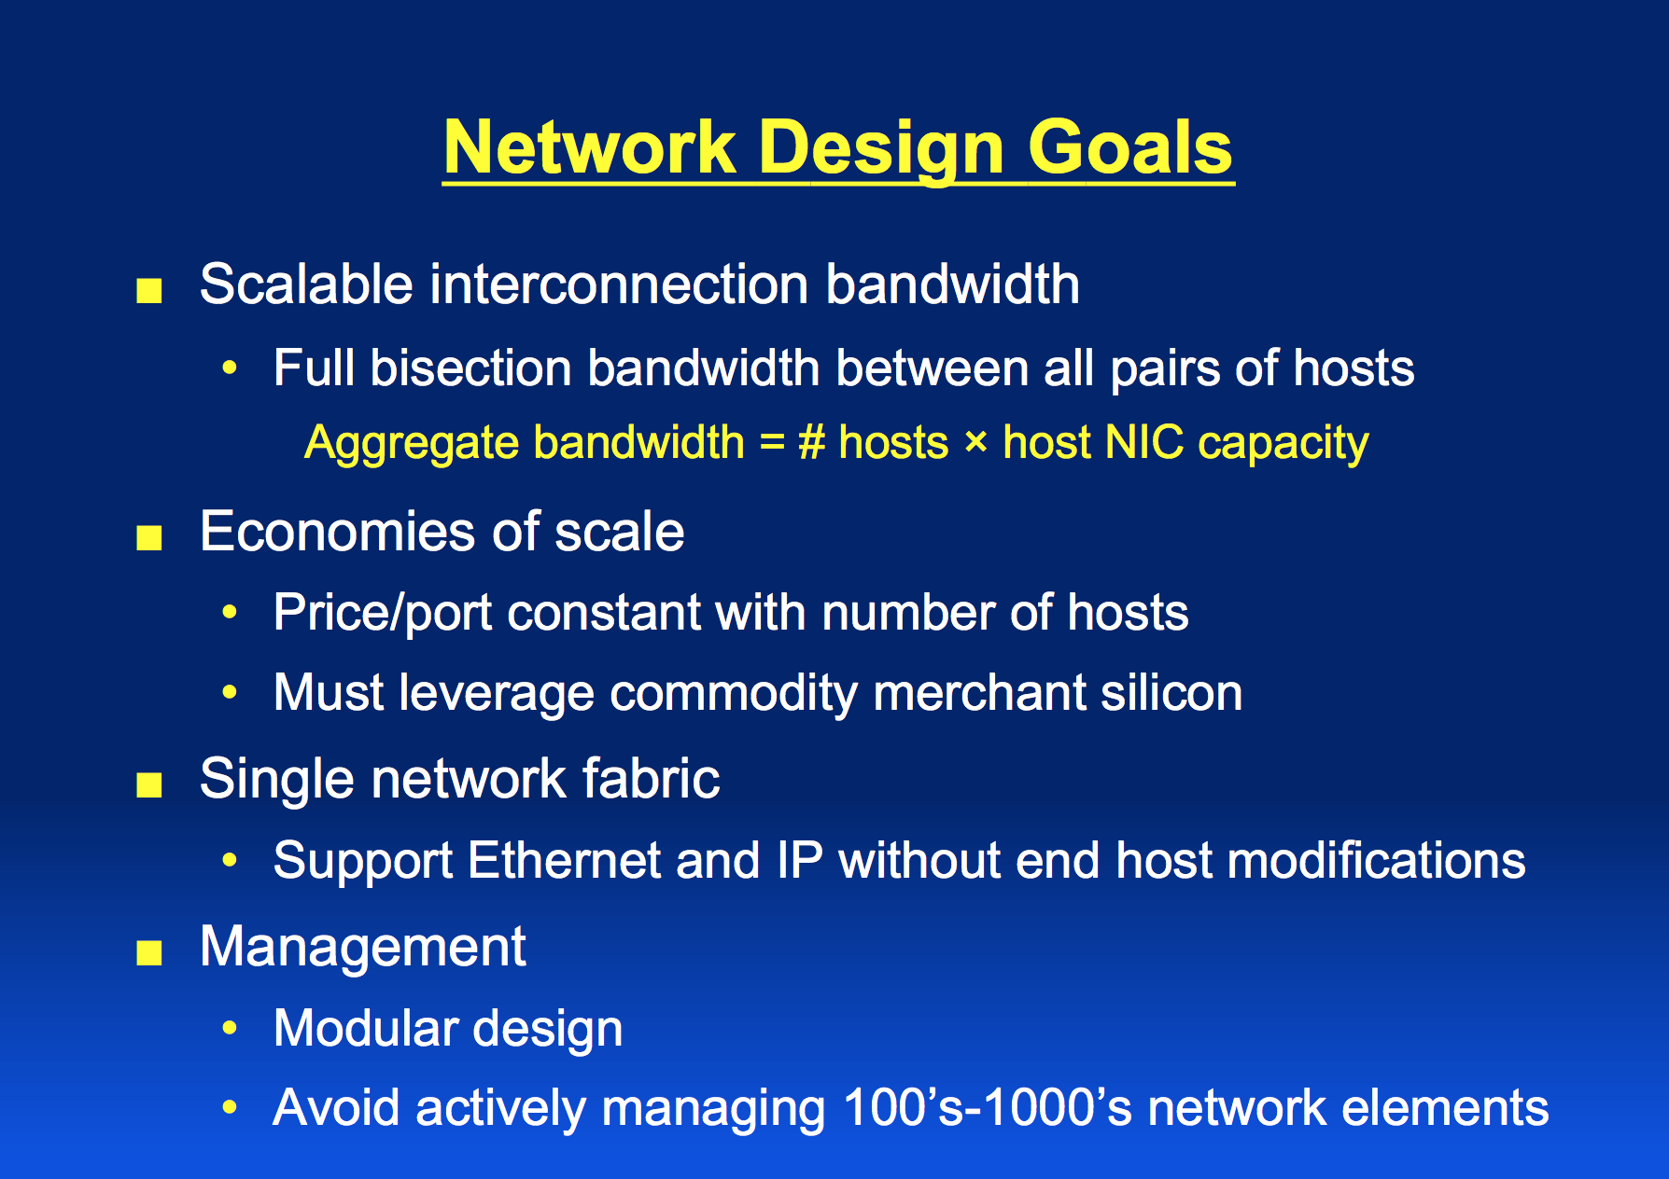

Slide 39
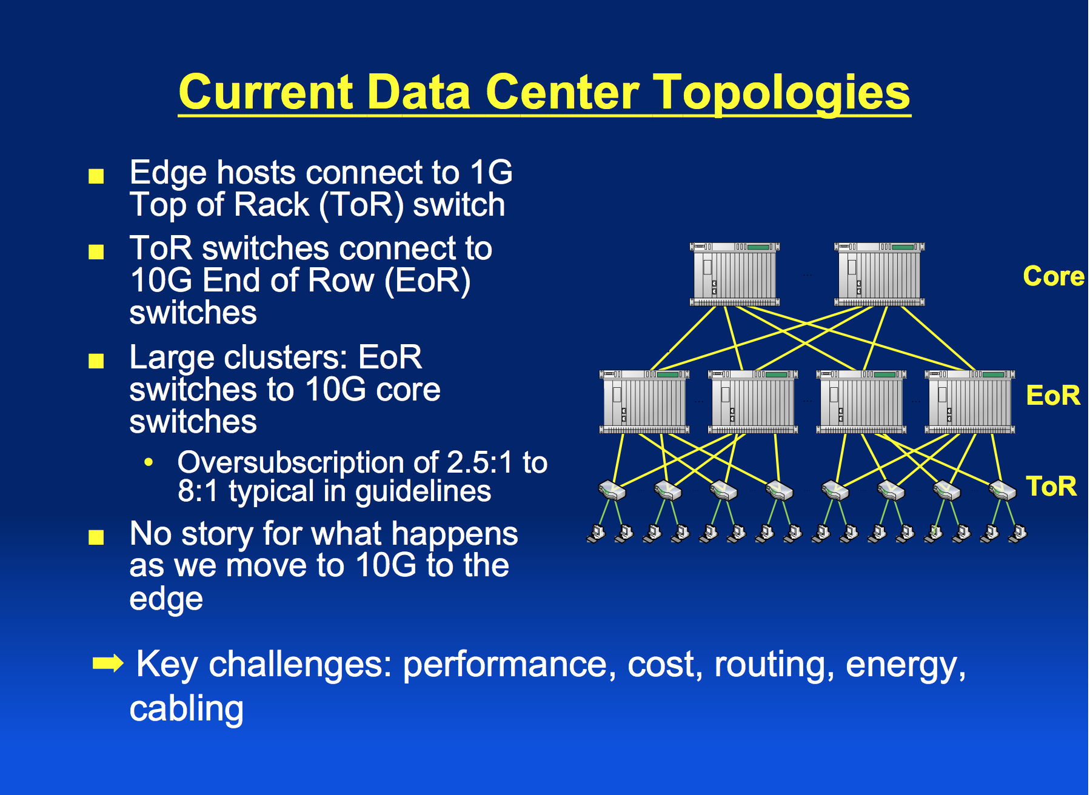

Slide 40
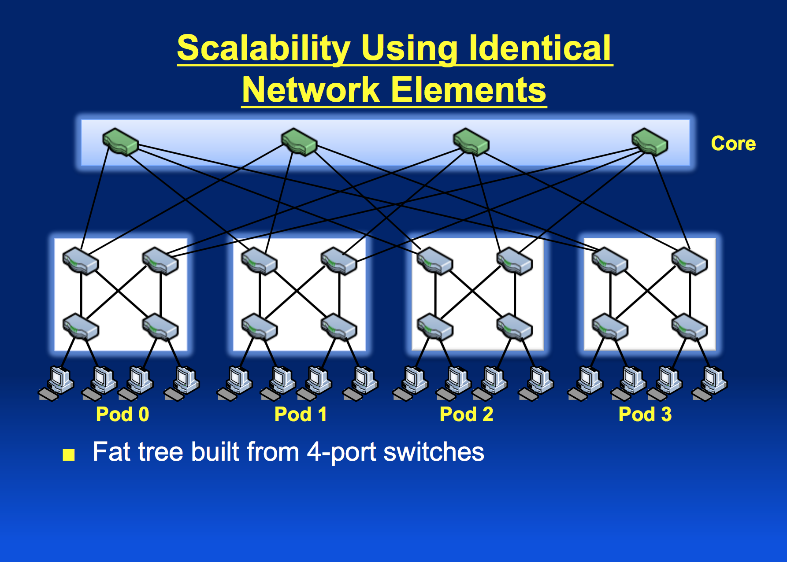

Slide 41
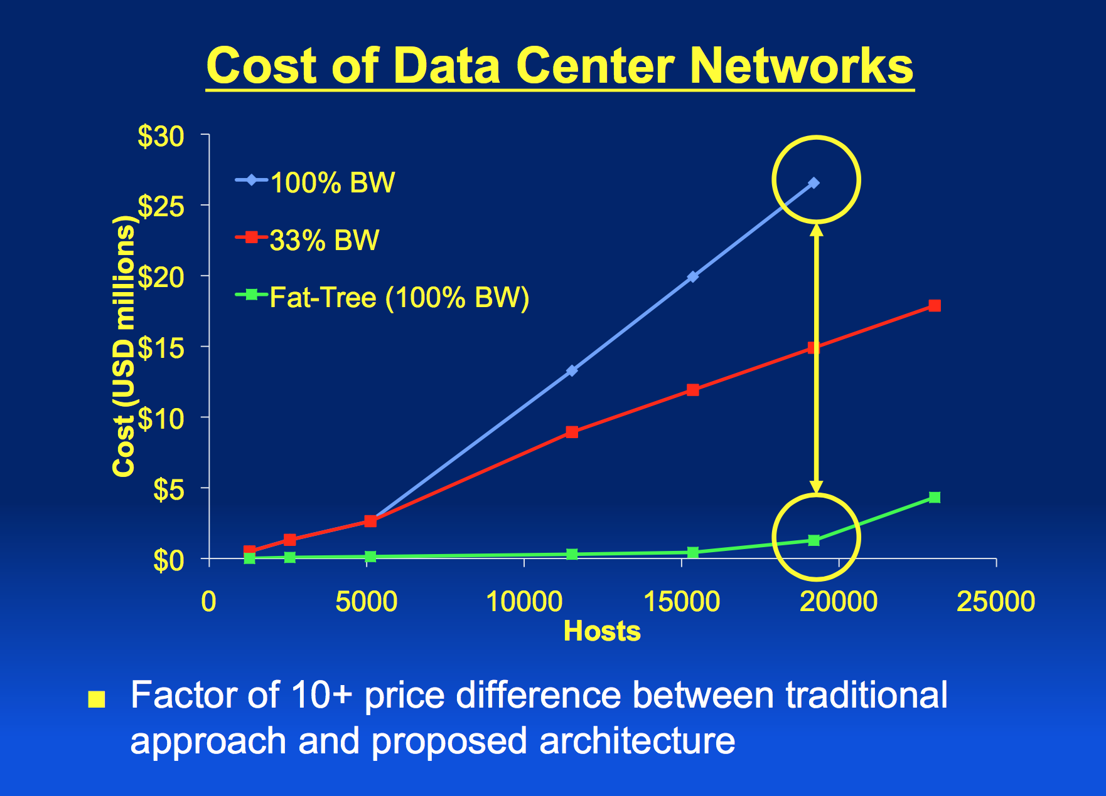

Slide 42
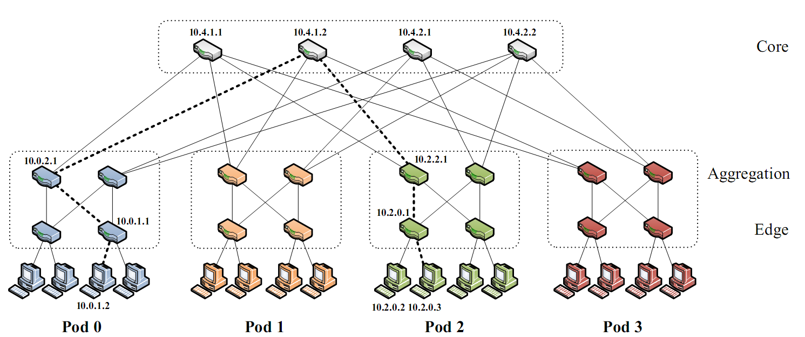
FatTree-based DC Architecture
Inter-connect racks (of servers) using a fat-tree topology
K-ary fat tree: three-layer topology (edge, aggregation and core)
each pod consists of (k/2)² servers & 2 layers of k/2 k-port switches
each edge switch connects to k/2 servers & k/2 aggr. switches
each aggr. switch connects to k/2 edge & k/2 core switches
(k/2)² core switches: each connects to k pods
Fat-tree with K=4

Slide 43
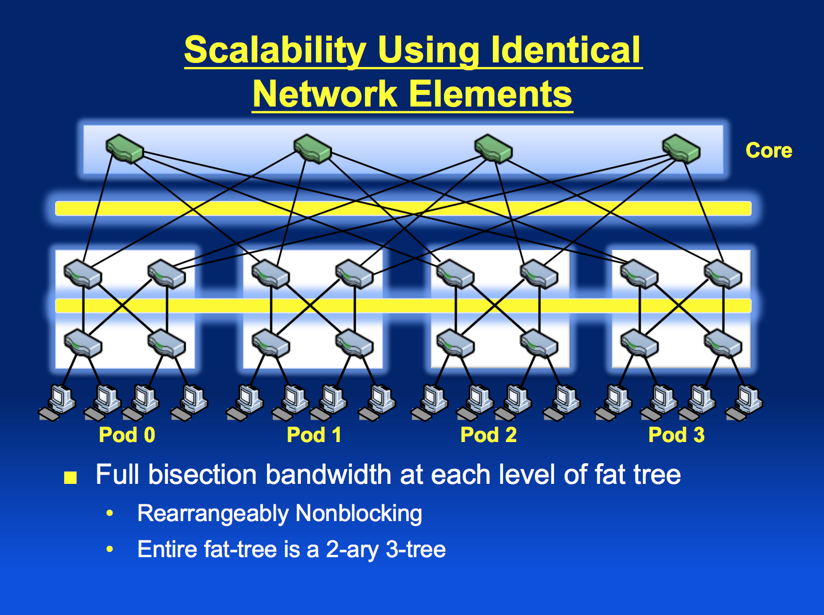

Slide 44
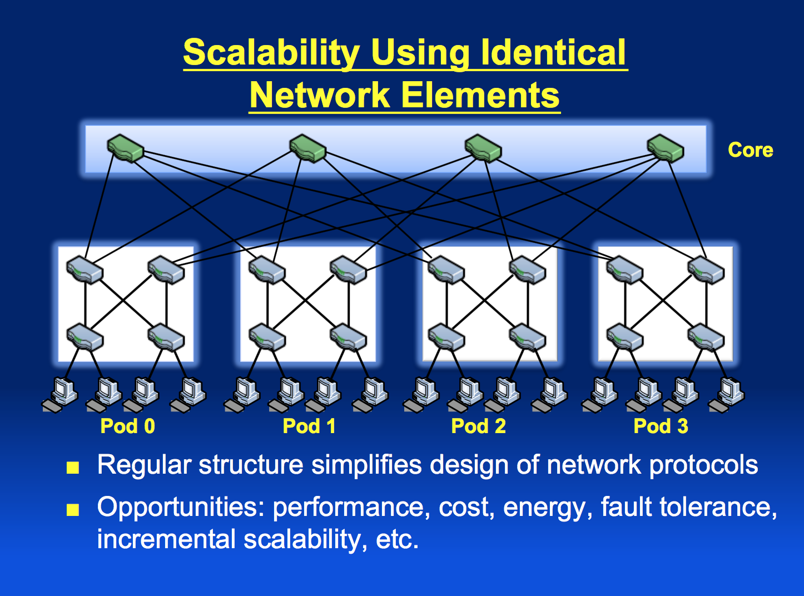

Slide 45
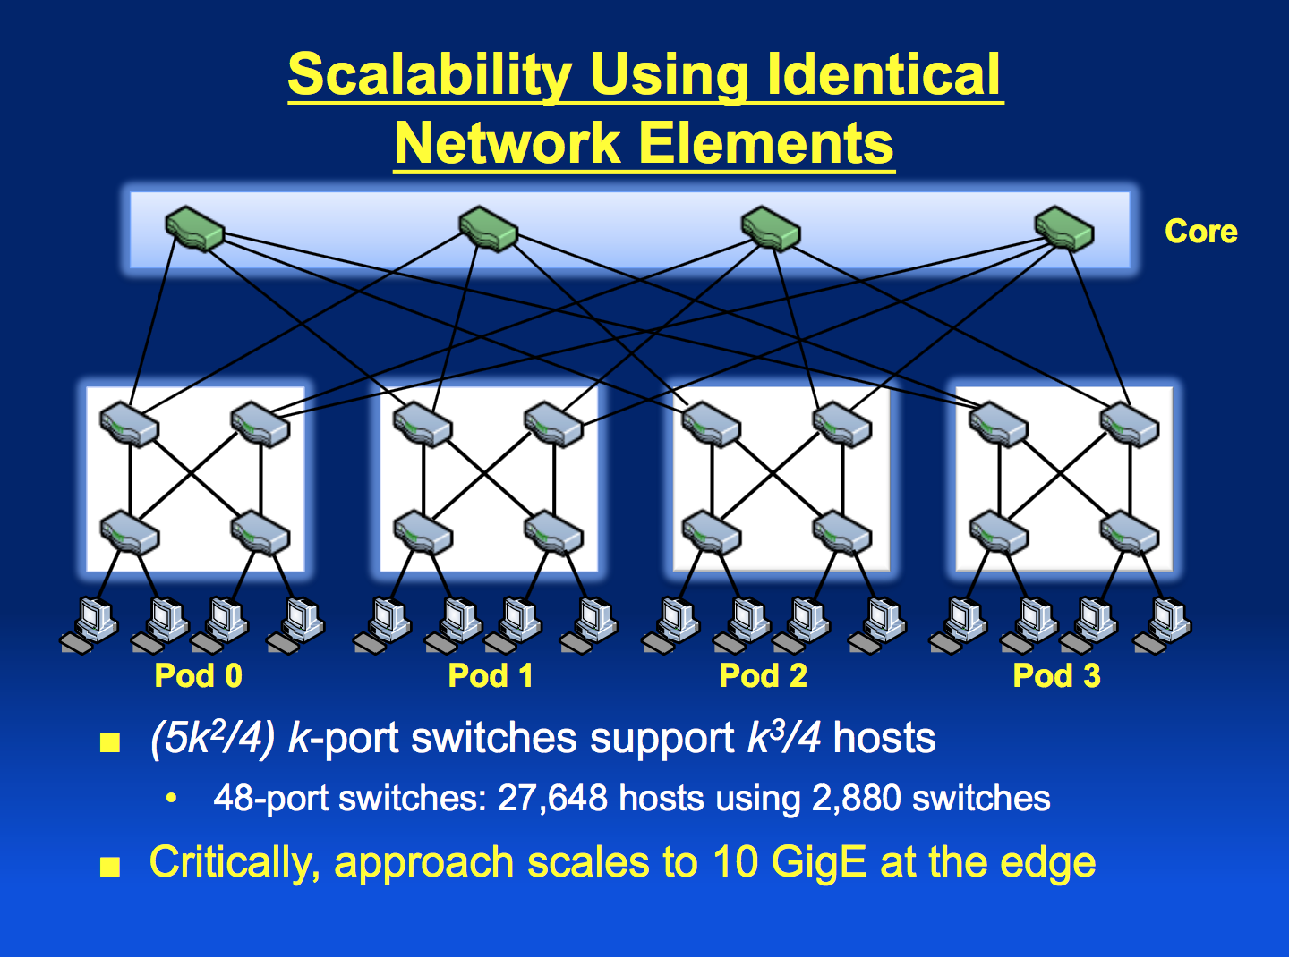

Slide 46
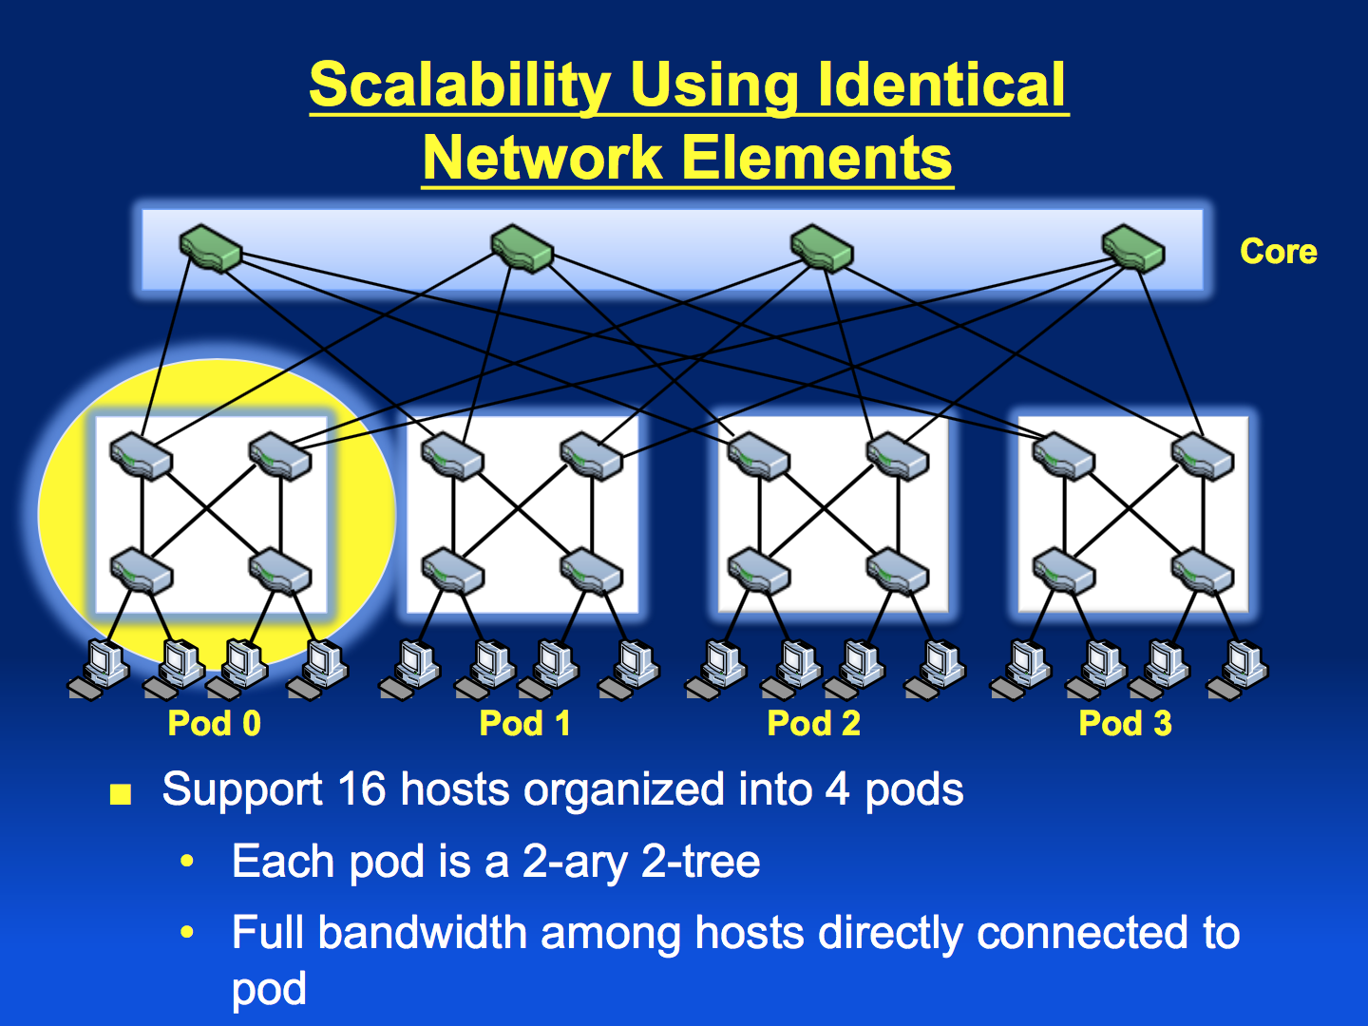

Slide 47
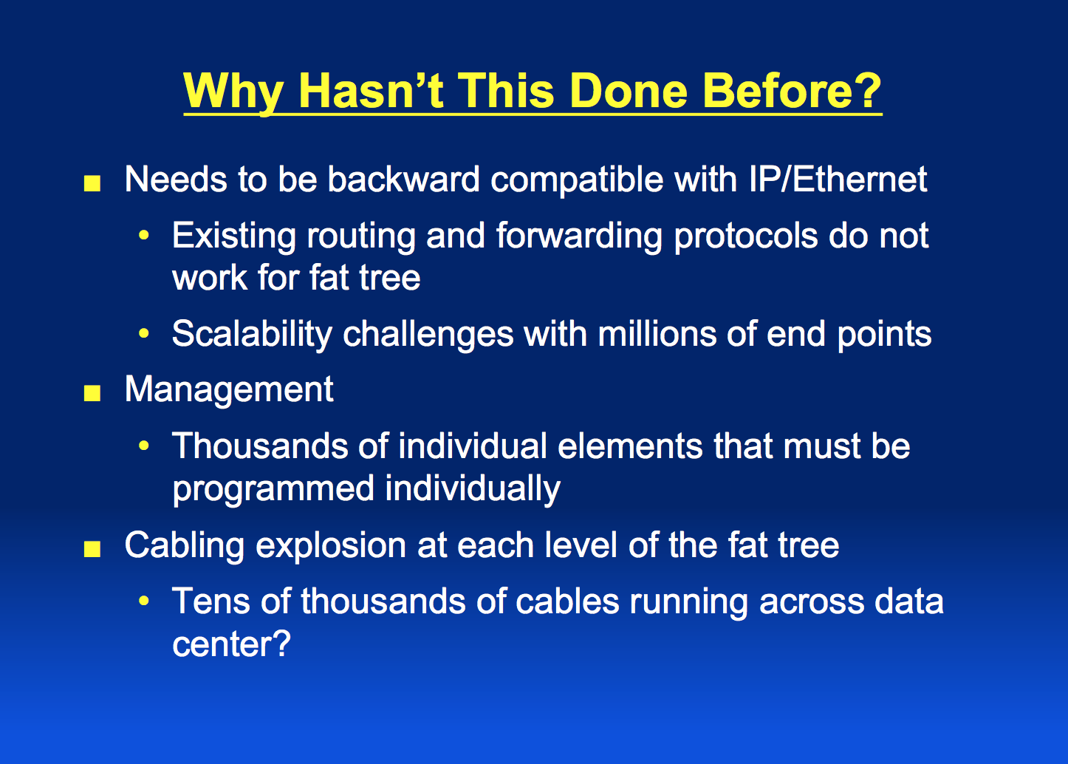

Slide 48
Properties of the solution
Backwards compatible with existing infrastructure
No changes in application
Support of layer 2 (Ethernet)
Cost effective
Low power consumption & heat emission
Cheap infrastructure
Allows host communication at line speed

Slide 49
Clos Networks/Fat-Trees
Adopt a special instance of a Clos topology
Similar trends in telephone switches led to designing a topology with high bandwidth by interconnecting smaller commodity switches.

Slide 50
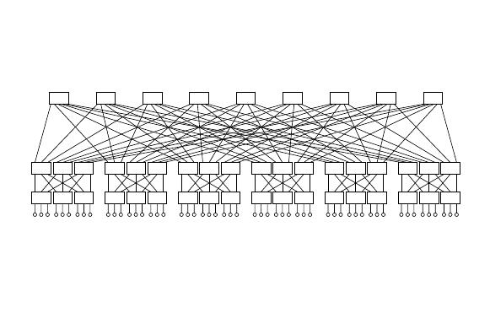
FatTree-based DC Architecture
Why Fat-Tree?
Fat tree has identical bandwidth at any bisections
Each layer has the same aggregated bandwidth
Can be built using cheap devices with uniform capacity
Each port supports same speed as end host
All devices can transmit at line speed if packets are distributed uniform along available paths
Great scalability: k-port switch supports k³/4 servers
Fat tree network with K = 6 supporting 54 hosts

Slide 51
FatTree Topology is great, But…
Does using fat-tree topology to inter-connect racks of servers in itself sufficient?
What routing protocols should we run on these switches?
Layer 2 switch algorithm: data plane flooding!
Layer 3 IP routing:
shortest path IP routing will typically use only one path despite the path diversity in the topology
if using equal-cost multi-path routing at each switch independently and blindly, packet re-ordering may occur; further load may not necessarily be well-balanced
Aside: control plane flooding!

Slide 52
Problems with Fat-tree
Layer 3 will only use one of the existing equal cost paths
Bottlenecks up and down the fat-tree
Simple extension to IP forwarding
Packet re-ordering occurs if layer 3 blindly takes advantage of path diversity ; further load may not necessarily be well-balanced
Wiring complexity in large networks
Packing and placement technique

Slide 53
Fat Tree Modified
Enforce a special (IP) addressing scheme in DC
unused.PodNumber.switchnumber.Endhost
Allows host attached to same switch to route only through switch
Allows inter-pod traffic to stay within pod

Slide 54
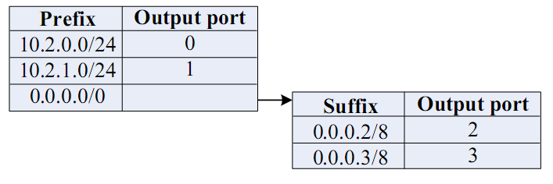
FatTree Modified
Use two level look-ups to distribute traffic and maintain packet ordering
First level is prefix lookup
used to route down the topology to servers
Second level is a suffix lookup
used to route up towards core
maintain packet ordering by using same ports for same server
Diffuses and spreads out traffic

Slide 55
FatTree Modified
Diffusion Optimizations (routing options)
1. Flow classification, Denote a flow as a sequence of packets; pod switches forward subsequent packets of the same flow to same outgoing port. And periodically reassign a minimal number of output ports
Eliminates local congestion
Assign traffic to ports on a per-flow basis instead of a per-host basis, Ensure fair distribution on flows

Slide 56
Fat Tree Modified
2. Flow scheduling, Pay attention to routing large flows, edge switches detect any outgoing flow whose size grows above a predefined threshold, and then send notification to a central scheduler. The central scheduler tries to assign non-conflicting paths for these large flows.
Eliminates global congestion
Prevent long lived flows from sharing the same links
Assign long lived flows to different links

Slide 57
Fault Tolerance
In this scheme, each switch in the network maintains a BFD (Bidirectional Forwarding Detection) session with each of its neighbors to determine when a link or neighboring switch fails
Failure between upper layer and core switches
Outgoing inter-pod traffic, local routing table marks the affected link as unavailable and chooses another core switch
Incoming inter-pod traffic, core switch broadcasts a tag to upper switches directly connected signifying its inability to carry traffic to that entire pod, then upper switches avoid that core switch when assigning flows destined to that pod

Slide 58
Fault Tolerance
Failure between lower and upper layer switches
Outgoing inter- and intra pod traffic from lower-layer,
the local flow classifier sets the cost to infinity and does not assign it any new flows, chooses another upper layer switch
Intra-pod traffic using upper layer switch as intermediary
Switch broadcasts a tag notifying all lower level switches, these would check when assigning new flows and avoid it
Inter-pod traffic coming into upper layer switch
Tag to all its core switches signifying its ability to carry traffic, core switches mirror this tag to all upper layer switches, then upper switches avoid affected core switch when assigning new flaws

Slide 59
Packing
Increased wiring overhead is inherent to the fat-tree topology
Each pod consists of 12 racks with 48 machines each, and 48 individual 48-port GigE switches
Place the 48 switches in a centralized rack
Cables moves in sets of 12 from pod to pod and in sets of 48 from racks to pod switches opens additional opportunities for packing to reduce wiring complexity
Minimize total cable length by placing racks around the pod switch in two dimensions

Slide 60
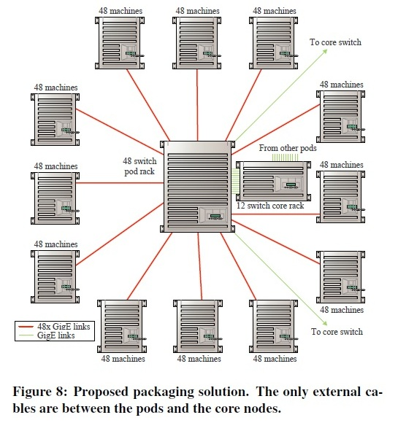
Packing

Slide 61
Evaluation
Benchmark suite of communication mappings to evaluate the performance of the 4-port fat-tree using the TwoLevelTable switches, FlowClassifier ans the FlowScheduler and compare to hirarchical tree with 3.6:1 oversubscription ratio

Slide 62
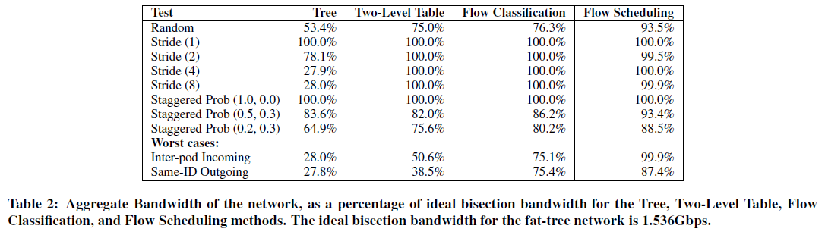
Results: Network Utilization

Slide 63
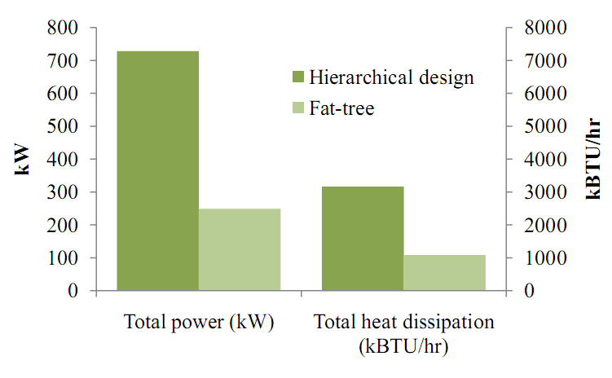
Results: Heat & Power Consumption

Slide 64
Perspective
Bandwidth is the scalability bottleneck in large scale clusters
Existing solutions are expensive and limit cluster size
Fat-tree topology with scalable routing and backward compatibility with TCP/IP and Ethernet
Large number of commodity switches have the potential of displacing high end switches in DC the same way clusters of commodity PCs have displaced supercomputers for high end computing environments

Slide 65
Other Data Center Architectures
A Scalable, Commodity Data Center Network Architecture
a new Fat-tree “inter-connection” structure (topology) to increases “bi-section” bandwidth
needs “new” addressing, forwarding/routing
VL2: A Scalable and Flexible Data Center Network
consolidate layer-2/layer-3 into a “virtual layer 2”
separating “naming” and “addressing”, also deal with dynamic load-balancing issues
Other Approaches:
PortLand: A Scalable Fault-Tolerant Layer 2 Data Center Network Fabric
BCube: A High-Performance, Server-centric Network Architecture for Modular Data Centers

